Slide 1
SOFTWARE PROJECT MANAGEMENT
Development Management
Dr. Seemab Latif
Lecture No. 10
19th April, 2011

Slide 2
Today
Project Roles & Team Structure
Project Control
Status Reporting

Slide 3
Project Roles
Programmers (system engineers)
  Technical lead, architect, programmer, Sr. programmer
Quality Assurance (QA) engineers (testers)
  QA Manager, QA Lead, QA staff
DBAs
  DB Administrator, DB Programmer, DB Modeler
Configuration Management engineers (build engineers)
Network engineers, System Administrators
Analysts (business analysts)
UI Designers
Information Architects
Documentation writers (editors, documentation specialist)
Project manager
Others--Security specialist, consultants, trainer

Slide 4
Project Roles--Class Activity
You need to decide which of these are necessary for your degree_x001a_project
Depends on what you’re building
    How big is it?
    Is it UI intensive? Data intensive?
    Are you installing/managing hardware?
    Do you need to run an operations center?
    Is it in-house, contract, COTS, etc?
Depends on your budget

Slide 5
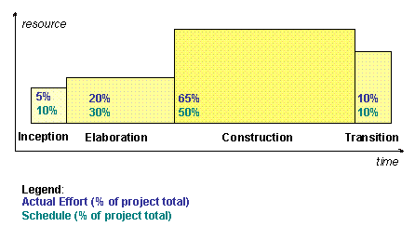
Staffing Profile
Projects do not typically have a ‘static team size’
Who and how many varies as needed
Copyright: Rational Software 2002

Slide 6
Roll-on & Roll-off
PM must have a plan as to how & when
Roll-on
  Hiring or ‘reserving’ resources
  Ramp-up time
    Learning project or company
Roll-off
  Knowledge transfer
  Documentation
  Cleanup

Slide 7
Staffing Management Plan
Part of Software Development Plan
Includes
  What roles needed, how many, when, who
  Resource assignments
  Timing: Start/stop dates
  Cost/salary targets (if hiring)
Project Directory
  Simply a list of those involved with contact info.
Team size: often dictated by budget as often as any other factor

Slide 8
Team Structure
1st: What’s the team’s objective?
  Problem resolution
    Complex, poorly-defined problem
    Focuses on 1-3 specific issues
    Sense of urgency
  Creativity
    New product development
  Tactical execution
    Carrying-out well-defined plan
    Focused tasks and clear roles
Example:_x0016_A group of maintenance programmers trying to diagnose a new showstopper defect.
Example:_x0016_A group of programmers who are breaking new ground in a multimedia application would be a creativity team.
Example:_x0016_A software team working on a well-defined product upgrade in which the purpose of the upgrade is not to break new ground but to put well-understood functionality into users' hands as quickly as possible.

Slide 9
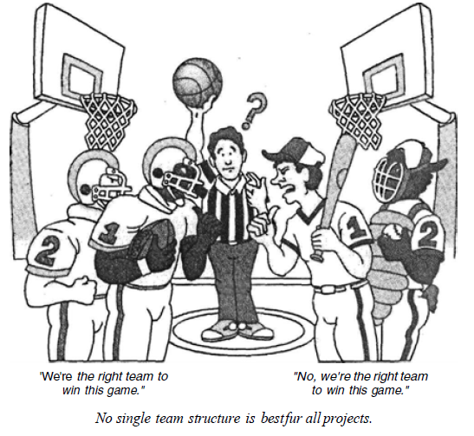

Slide 10
Team Models
Two early philosophies
  Decentralized Democratic (DD)
  Controlled Centralized (CC)
Variation
  Controlled Decentralized (CD)

Slide 11
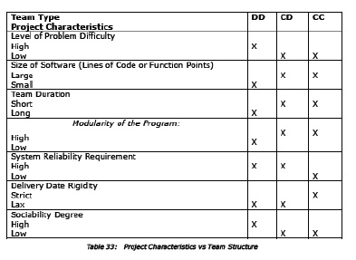
Team Models

Slide 12
Team Models
Business Team
  Most common model
  Technical lead + team (rest team at equal status)
  Hierarchical with one principal contact
  Adaptable and general
  Variation: Democratic Team
    All decisions made by whole team

Slide 13
Team Models
Chief-Programmer Team
  From IBM in 70’s
  a.k.a. ‘surgical team’
  Puts a superstar at the top
    Others then specialize around him/her
      Backup Programmer
      Co-pilot or alter-ego
      Administrator
      Toolsmith
      “Language lawyer”
  Issues
      Difficult to achieve
      Ego issues: superstar and/or team
  Can be appropriate for creative projects or tactical execution

Slide 14
Team Models
Skunkworks Team
  Put a bunch of talented, creative developers away from the mother ship
    Off-site literally or figuratively
  Pro: Creates high ownership & buy-in
  Con: Little visibility into team progress
  Applicable: exploratory projects needing creativity
    Not on well-defined or narrow problem

Slide 15
Team Models
SWAT Team
    Highly skilled team
    Skills tightly match goal
    Members often work together
    SWAT team useful for tactical-execution and problem-resolution projects.

Slide 16
Team Models
Large teams
  Communication increases multiplicatively
    Square of the number of people
    50 programmers = 1200 possible paths
    Communication must be formalized
  Always use a hierarchy
  Reduce units to optimal team sizes
    Always less than 10

Slide 17
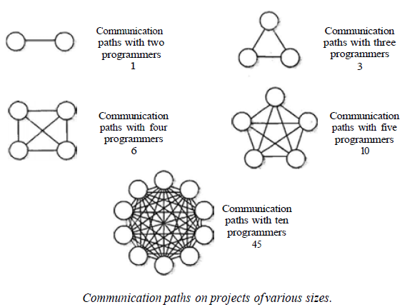
Large Teams

Slide 18
Team Size
What is the optimal team size?
    4-6 developers
      Tech lead + developers
    Small projects inspire stronger identification
    Increases cohesiveness

Slide 19
Responsibility Assignment Matrix
A resource planning tool
Who does What
Can be for both planning and tracking
Identify authority, accountability, responsibility
Who: can be individual, team or department
Can have totals/summary at end of row or column (ex: total Contributors on a task)

Slide 20
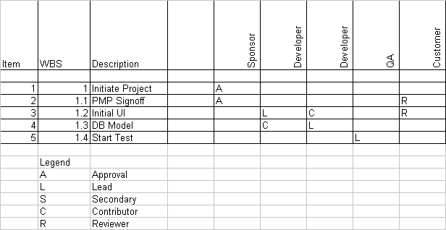
Simple RAM

Slide 21
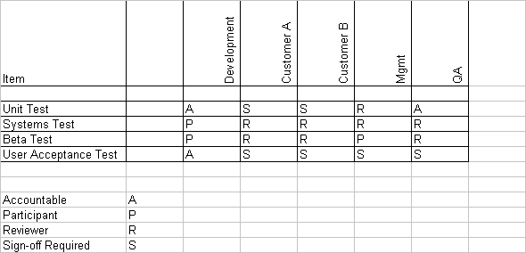
Sample RAM With Stakeholders

Slide 22
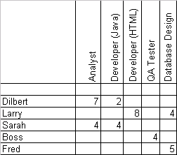
Skills Matrix
Another resource planning tool
Resources on one axis, skills on other
Skills can high level or very specific
Cells can be X’s or numeric (ex: level, # yrs.)

Slide 23
Quiz
What Risks are involved on your project

